Slide 1
Lecture 3 Organization strategy and project selection
Content
Strategic management process
Project portfolio management

Slide 2
Strategic management process
What is strategic management process?
Why Project Managers Need to Understand the Strategic Management Process?

Slide 3
What is strategic management process?
The strategic management process is the systematic analysis of an organization’s internal and external environment to achieve and retain a competitive advantage.
Strategic Management Process includes 4 following activities:
Review/revise and define the organizational mission.
Set long-range goals and objectives.
Analyze and formulate strategies to reach objectives.
Implement strategies through projects.
Strategic management is the process of assessing “what we are” and deciding and implementing “what we intend to be and how we are going to get there.”

Slide 4
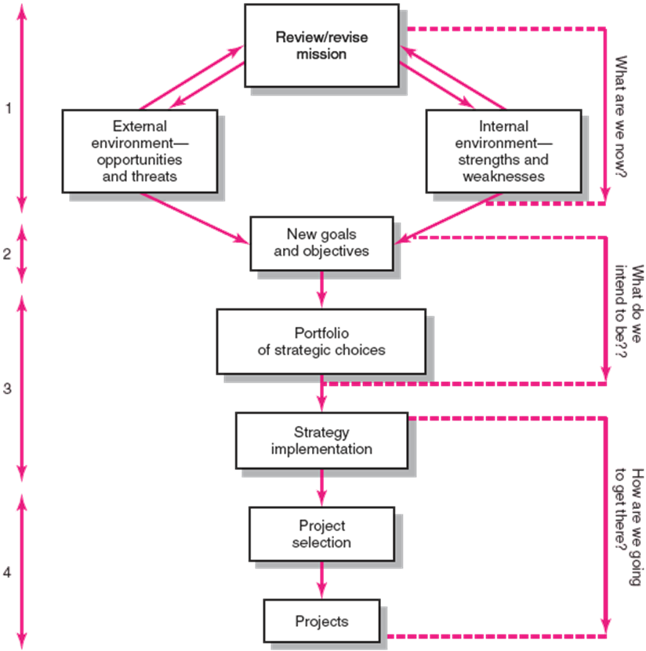
What is strategic management process?

Slide 5
Why Project Managers Need to Understand the Strategic Management Process?
Strategic Management
- Provides the theme and focus of the future direction for the firm.
Responding to changes in the external environment—environmental scanning
Allocating scarce resources of the firm to improve its competitive position—internal responses to new action programs
Requires strong links among mission, goals, objectives, strategy, and
implementation.
Changes in the Organization’s Mission and Strategy
Project managers must respond to changes with appropriate decisions about future projects and adjustments to current projects.
Project managers who understand their organization’s strategy can become
effective advocates of projects aligned with the firm’s mission.

Slide 6
Project portfolio management
Project Portfolio Management Problems
Benefits of Project Portfolio Management
A Portfolio Management System

Slide 7
Project Portfolio Management Problems
The Implementation Gap
The lack of understanding and consensus on strategy among top management and middle-level (functional) managers who independently implement the strategy
Organization Politics
Project selection is based on the persuasiveness and power of people advocating the projects.
Resource Conflicts and Multitasking
The multi-project environment creates interdependency relationships of shared resources which results in the starting, stopping, and restarting projects.

Slide 8
Benefits of Project Portfolio Management
Builds discipline into project selection process.
Links project selection to strategic metrics.
Prioritizes project proposals across a common set of criteria, rather than on politics or emotion.
Allocates resources to projects that align with strategic direction.
Balances risk across all projects.
Justifies killing projects that do not support organization strategy.
Improves communication and supports agreement on project goals.

Slide 9
A Portfolio Management System
Selection criteria
Selection model
Managing the portfolio

Slide 10

Selection criteria
Financial criteria
$NPV=\sum_{i=0}^{n}{\frac{\left(B_{i}−C_{i}\right)}{{\left(1+r\right)}^{i}}>0}$
$NPV=\sum_{i=0}^{n}{\frac{\left(B_{i}−C_{i}\right)}{{\left(1+IRR\right)}^{i}}=0}$
$\sum_{i=0}^{n}{\frac{T_{i}}{{\left(1+r\right)}^{i}}=}\sum_{i=0}^{n}{\frac{C_{i}}{{\left(1+r\right)}^{i}}}$
$PV\left(\frac{B}{C}\right)=\frac{\sum_{i=0}^{n}{\frac{B_{i}}{{\left(1+r\right)}^{i}}}}{\sum_{i=0}^{n}{\frac{C_{i}}{{\left(1+r\right)}^{i}}}}>1$

Slide 11
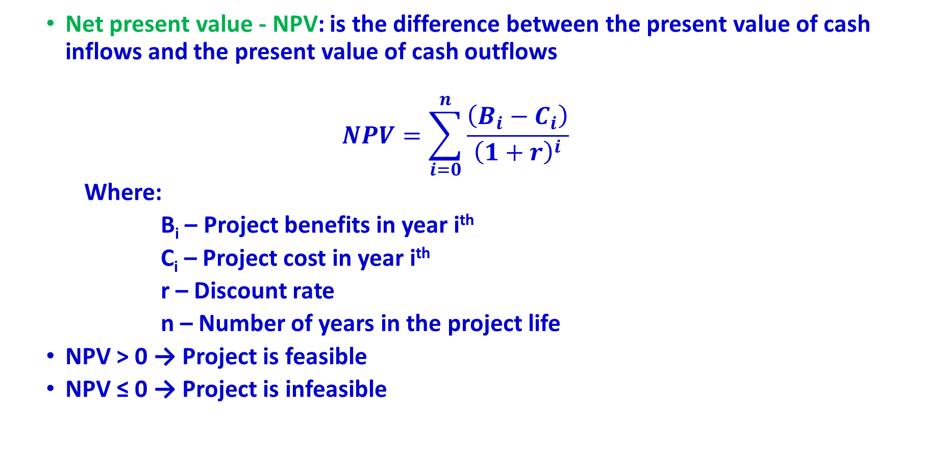
Financial criteria
Net present value - NPV: is the difference between the present value of cash inflows and the present value of cash outflows
$$NPV=\sum_{i=0}^{n}{\frac{\left(B_{i}−C_{i}\right)}{{\left(1+r\right)}^{i}}}$$
Where:
B_{i} – Project benefits in year i^{th}
C_{i} – Project cost in year i^{th}
r – Discount rate
n – Number of years in the project life
NPV > 0 → Project is feasible
NPV ≤ 0 → Project is infeasible

Slide 12
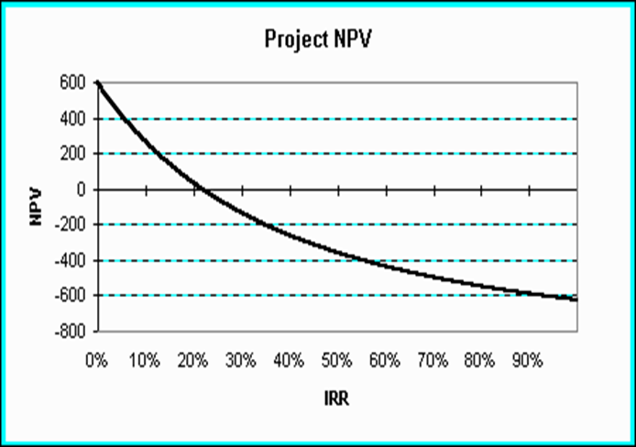
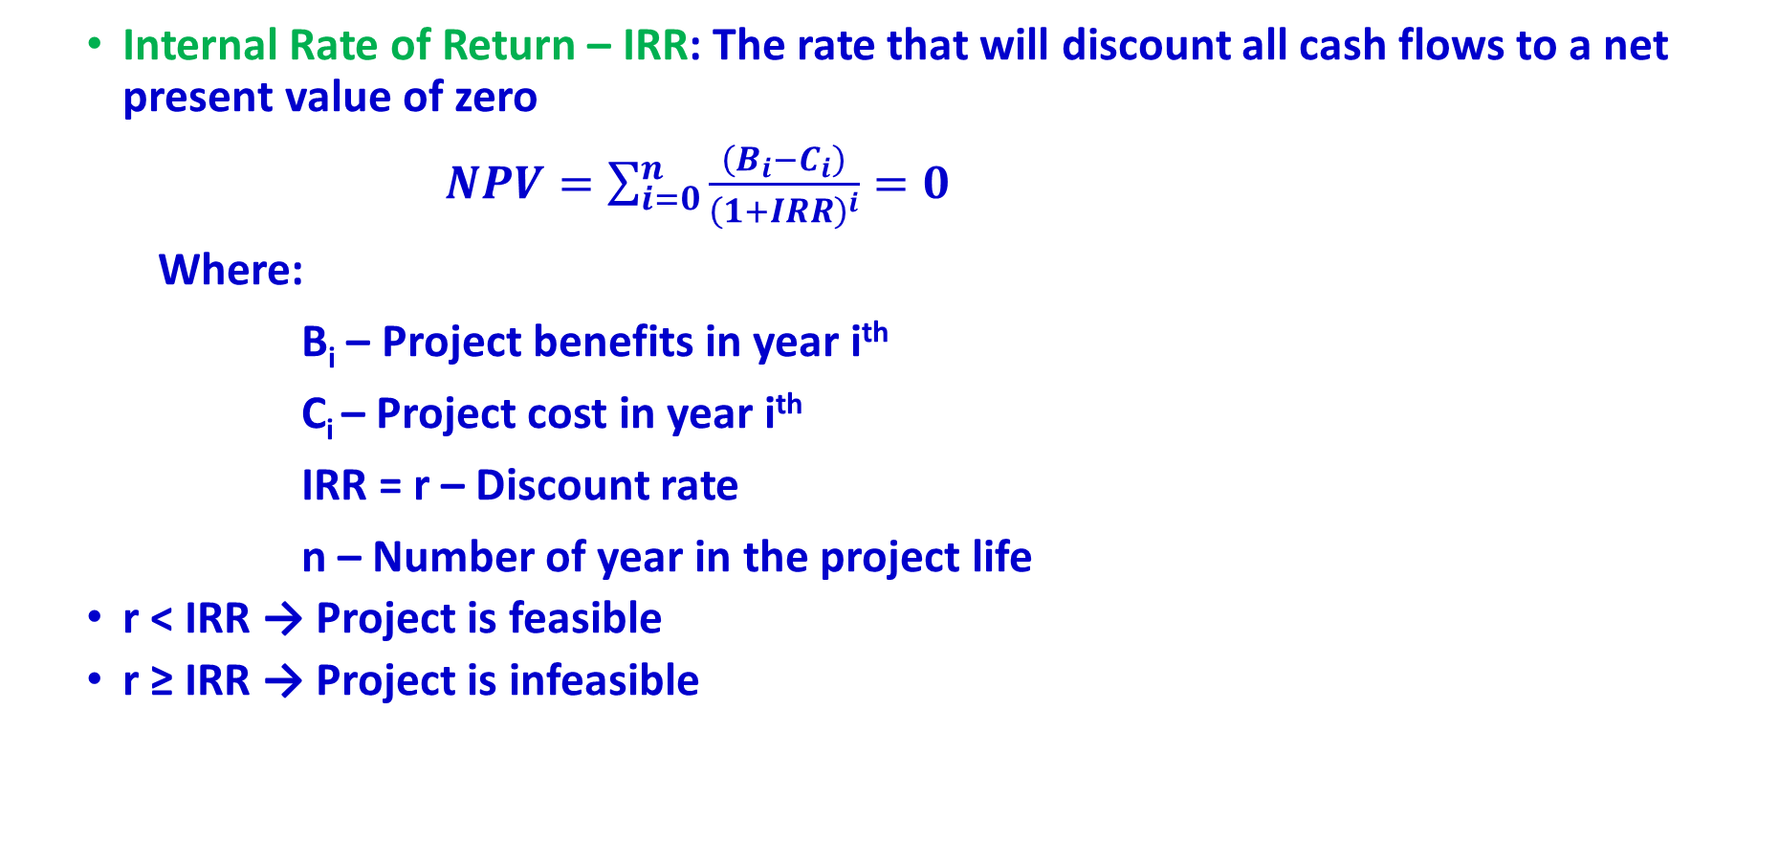
Financial criteria
Internal Rate of Return – IRR: The rate that will discount all cash flows to a net present value of zero
$NPV=\sum_{i=0}^{n}{\frac{\left(B_{i}−C_{i}\right)}{{\left(1+IRR\right)}^{i}}}=0$
Where:
B_{i} – Project benefits in year i^{th}
C_{i} – Project cost in year i^{th}
IRR = r – Discount rate
n – Number of year in the project life
r < IRR → Project is feasible
r ≥ IRR → Project is infeasible

Slide 13
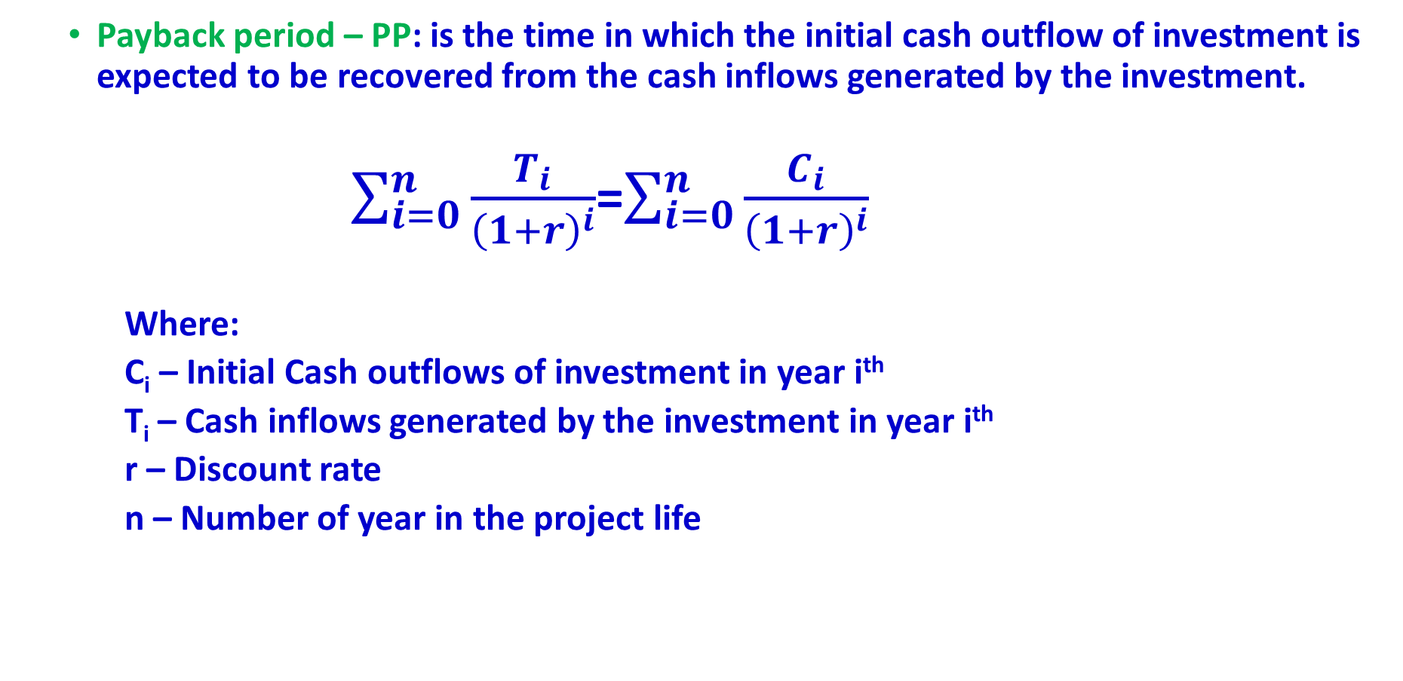
Financial criteria
Payback period – PP: is the time in which the initial cash outflow of investment is expected to be recovered from the cash inflows generated by the investment.
$\sum_{i=0}^{n}{\frac{T_{i}}{{\left(1+r\right)}^{i}}}$=$\sum_{i=0}^{n}{\frac{C_{i}}{{\left(1+r\right)}^{i}}}$
Where:
C_{i} – Initial Cash outflows of investment in year i^{th}
T_{i} – Cash inflows generated by the investment in year i^{th}
r – Discount rate
n – Number of year in the project life

Slide 14
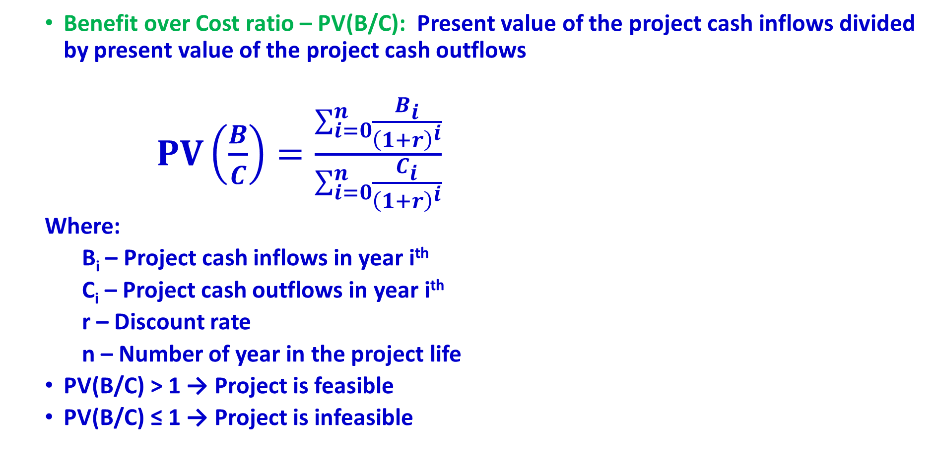
Financial criteria
Benefit over Cost ratio – PV(B/C): Present value of the project cash inflows divided by present value of the project cash outflows
$PV\left(\frac{B}{C}\right)=\frac{\sum_{i=0}^{n}{\frac{B_{i}}{{\left(1+r\right)}^{i}}}}{\sum_{i=0}^{n}{\frac{C_{i}}{{\left(1+r\right)}^{i}}}}$
Where:
B_{i} – Project cash inflows in year i^{th}
C_{i} – Project cash outflows in year i^{th}
r – Discount rate
n – Number of year in the project life
PV(B/C) > 1 → Project is feasible
PV(B/C) ≤ 1 → Project is infeasible

Slide 15
Selection criteria
Non-financial criteria
For the profit-oriented project
To capture larger market share
To make it difficult for competitors to enter the market
To develop an enabler product
To develop core technology that will be used in next-generation products
To reduce dependency on unreliable suppliers
b. For the socio-economic project
To reduce poverty
To improve gender equity
To reduce Rich-poor gap
To improve public services (administration, health care, education, etc.)
To increase GDP growth

Slide 16
Project Selection Model
Financial Model
If there is only one project
NPV > 0
or
IRR > r
or
PV(B/C) > 1
b. If there are more than one projects and all projects have the same life time
Max(NPV₁, NPV₂, …, NPV_{n}) > 0
or
Min (PP₁, PP₂, … , PP_{n})
or
Max(IRR₁, IRR₂, …, IRR_{n}) > r_{s} (r_{s} – Discount rate of the selected project)
or
Max{PV(B₁/C₁), PV(B₂/C₂), …, PV(B_{n}/C_{n})} > 1

Slide 17
Project Selection Model
Financial Model
c. If there are more than one projects and all project’s life times are different
First, make all project life times equal by using lowest common multiple, then follow below criteria:
Max(NPV₁, NPV₂, …, NPV_{n}) > 0
or
Min (PP₁, PP₂, … , PP_{n})
or
Max(IRR₁, IRR₂, …, IRR_{n}) > r_{s} (r_{s} – Discount rate of the selected project)
or
Max{PV(B₁/C₁), PV(B₂/C₂), …, PV(B_{n}/C_{n})} > 1

Slide 18
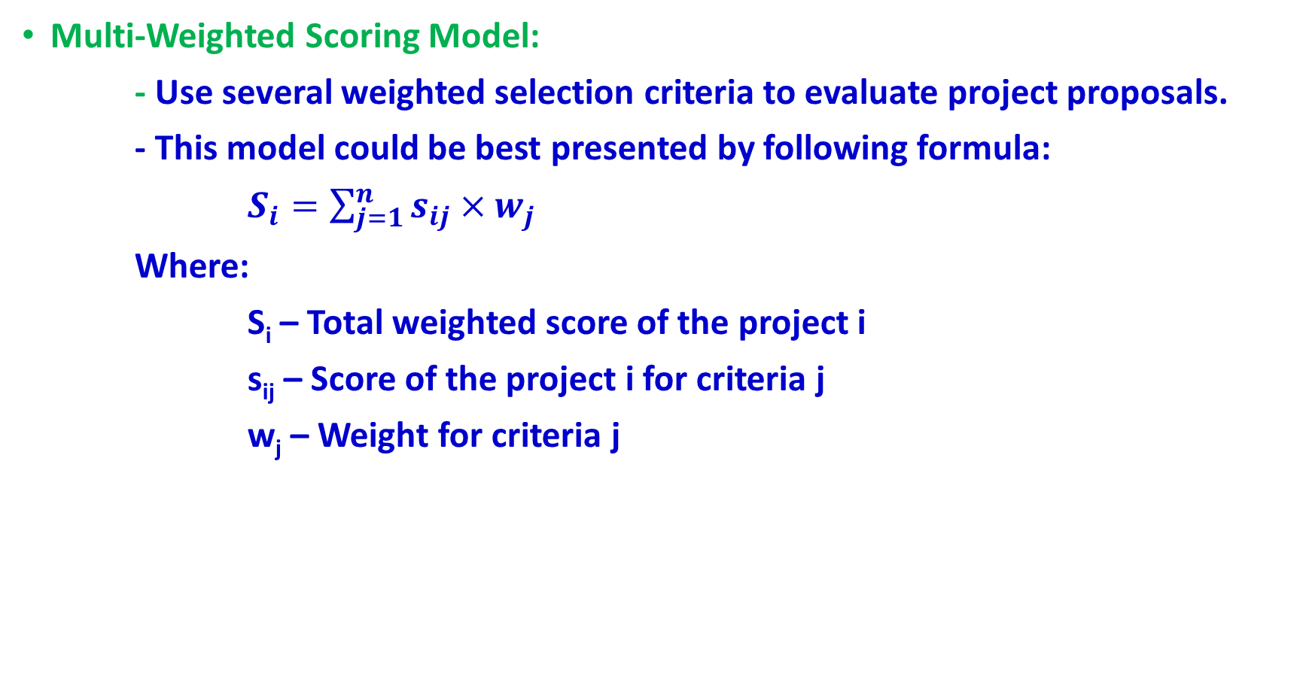
Project Selection Model
Multi-Weighted Scoring Model:
- Use several weighted selection criteria to evaluate project proposals.
- This model could be best presented by following formula:
$S_{i}=\sum_{j=1}^{n}{s_{ij}×w_{j}}$
Where:
S_{i} – Total weighted score of the project i
s_{ij} – Score of the project i for criteria j
w_{j} – Weight for criteria j

Slide 19
Project Selection Model
Applying selection model
- List all selection criteria that would best fit to the organization’s strategy
and goals
- Assign a weight to each selection criteria based on its importance to the
organization’s strategy
- Set a scoring scale of 5, 10, 20, 50 or 100, etc, then give a score to
each project’s criteria
- Multiply weights with corresponding scores to get the weighted score,
then sum up all weighted scores to have a total weighted score for the project
- List all projects based on its total weighted scores from high to low
- Select projects based on their scores and resources available to implement

Slide 20
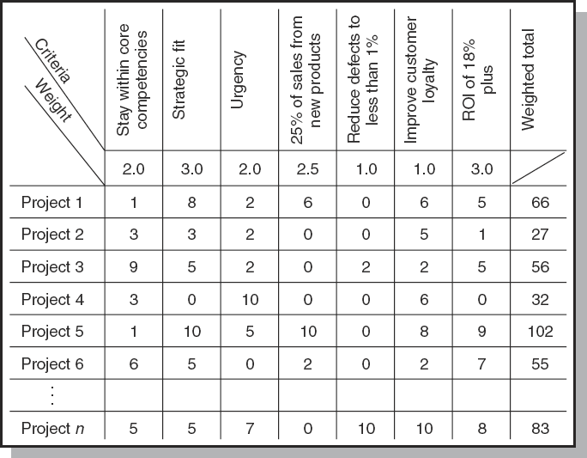
Example of Project Selection Model

Slide 21
Managing the portfolio
Senior Management Input
Provide guidance for selecting criteria that are aligned with the organization’s
goals
Decide how to balance available resources among current projects
The Priority Team Responsibilities
- Publish the priority of every project
- Ensure that the project selection process is open and free of power politics
- Reassess the organization’s goals and priorities
- Evaluate the progress of current projects

